Slide 1

GraphQL Architecture Study
OPEN
OPEN date: 06/05/2020
Ver 1.0

Slide 2
Agenda: OPEN gate
1
List of Attendees
2
Problem Statement
3
Context & Objectives
4
Pre-study input, activities & Output
5
Budget / Resources
6
Time Line
7
OPEN decision
Appendix
Notes:
Agenda slide

Slide 3
List of attendees at OPEN gate
OPEN gate
Name | Attendance
Remi POUJEAUX
Kevin BERTHOLIO
Hirok DUTTA CHOUDHURY
Siddharatha NAGAVARAPU
Nabil EL ABED
Dorian DINH
Notes:
This is an example of a Text Slide. Reference the different layout options in the Slide Master (under the View tab) for different variations. Remember, our new Brand Guidelines call for clean and simple messages and design. Reference the PowerPoint Guidelines on the Brand Book for tips and useful information on creating effective presentations.

Slide 4
Problem Statement
OPEN gate
To assess GrapqhQL usage in Client & Partners facing applications as well as back-office tools.
Notes:
Section title with image slide

Slide 5
Context & Objectives
Context
Limited resources for designing, documenting, building, testing.
API Composition layer is too technical and not federated.
Introspecting the backend models to design an API could be time consuming and is still too static (not all backends have a metamodel explorer…)
BFF are multiplying and APIs shall be flexible and optimized in terms of served data.
Time between design and production for small changes are sometimes not compatible with project timelines.
Consuming APIs is still coupled to backend knowledge which could be an obstacle for innovation velocity.
Objectives
Offer an alternative way to design interfaces (consumer-oriented interface) and consume services.

Slide 6
Pre-Study Input : Scope
Functional Scope :
As a Developer, I only retrieve the fields which need to be displayed in a web component or a service and i’m decoupled from the API versions.
As a API Owner, I focus on designing canonical APIs that can be rearranged at will for developer needs.
Technical Scope : GraphQL query on top of the CRM + *.
QDO
*
APIM + GRAPHQL
CRM
*
Notes:
GraphQL only returns the data that’s explicitly requested, so new capabilities can be added via new types and new fields on those types without creating a breaking change. This has led to a common practice of always avoiding breaking changes and serving a versionless API.
GraphQL adding to an API doesn’t break backward compatibility.
This approach at least allows for the addition of features, but what about removal?
GraphQL defines a @deprecated directive to mark fields or enums that should no longer be used.

Slide 7
Schneider Digital Reference Architecture – Application Execution
Customer
Engagement
Customer Identity
Employee
Engagement
Employee Identity
UI
analytics
Front-end
user
Code
control
Logging
Customer Experience Layer
Employee Experience Layer
Env
mgt
Monitoring
API management
API
Service
Integration
File
Request
Pub/sub
Operations
Development
Search
Business Logic
Access control
Operational
Reporting
User
Profile
Workflows
Back-end
System of Record
IT
Testing
Enterprise Data Object
Insights
Analytics
Data
visualization
Insight to action
EcostruXure
Template
Version 1.4
Edge control
Machine Data Object
IOT
Connected Products
Asset
Identity
Notes:
This is an example of a Text Slide. Reference the different layout options in the Slide Master (under the View tab) for different variations. Remember, our new Brand Guidelines call for clean and simple messages and design. Reference the PowerPoint Guidelines on the Brand Book for tips and useful information on creating effective presentations.

Slide 8
Pre-Study Input : End to End General Integration
Front Ends
?
AWS AppSync (embed a GraphQL server)
SE API Manager
GraphQL Gateway
& Query execution engine
Back Ends

Slide 9
Pre-Study Input : Principles
GraphQL APIs shall be managed.
GraphQL APIs shall be exposed by SE APIM. SE APIM still remain the facade.
GraphQL API Queries shall be READ operations only.
GraphQL Resolver shall leverage on existing Managed APIs.
GraphQL Resolver could be considered as a query engine for some data sources but shall be consumed through managed APIs.
GraphQL Schema Registry will be centralized.
GraphQL as a proxy for front-end (seamless case) ? TBC

Slide 10
Pre-Study : Output / Expected Deliverables
Position paper for GraphQL : pros & cons.
Pilot scope : set of GraphQL APIs on top of the CRM and other backends (to be proposed).
A GraphQL reference architecture in SE :
Detailed integration architecture of a GraphQL Platform.
Authentication & Authorization management.
Error handling and partial responses.
Organization & Workflow Proposal for adding/modifying a Schema (federated vs centralized).
Performance.
Usage principles for Front-Ends and Back-Ends.

Slide 11
Budget / Resources
DSS API Budget ?
Other ?
Estimated Budget : 40-50K€ ?
Originally external resources were planned…

Slide 12
Time line
Open
Position
Paper
Close
2020 | May | Jun | Jul | Aug | Sep | Oct | Nov
2021

Slide 13
Open decision
OPEN gate
Name | Attendance | Go / No Go
Remi POUJEAUX
Kevin BERTHOLIO
Hirok DUTTA CHOUDHURY
Siddharatha NAGAVARAPU
Nabil EL ABED
Dorian DINH
Notes:
This is an example of a Text Slide. Reference the different layout options in the Slide Master (under the View tab) for different variations. Remember, our new Brand Guidelines call for clean and simple messages and design. Reference the PowerPoint Guidelines on the Brand Book for tips and useful information on creating effective presentations.

Slide 14
Appendix
x

Slide 15
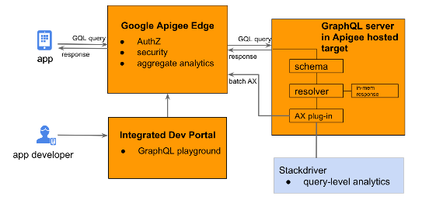
Appendix A
Apigee integration
Source : https://community.apigee.com/articles/70159/google-apigee-and-graphql.html

Slide 16
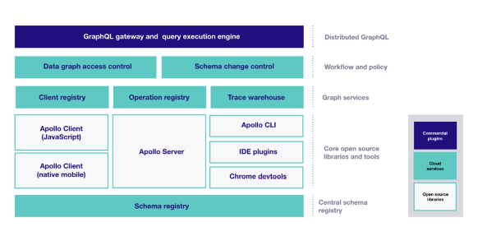
Appendix B
Apollo GraphQL Manager
Source : https://www.apollographql.com/blog/introducing-the-apollo-graphql-platform-8ef34bb269e5

Slide 17
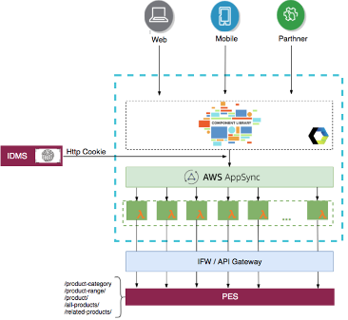
Appendix C
UIaaS Solution Architecture
Source : https://schneider.atlassian.net/wiki/spaces/PESV3/pages/1534099504/UIaaS+for+Catalog.+Solution+Architecture

